Slide 1
Lesson 11: CN4003
Website Testing and Documentation
Dr Fadi Safieddine
1

Slide 2
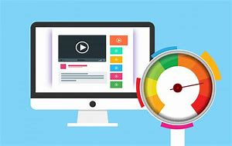
Contents
Introduction
Functionality Testing
User Acceptance
Testing Check List
User Feedback
Documentation
Notes:
Presentation outline
SECTION 1 Introduction
SECTION 2 Functionality Testing
SECTION 3 User Acceptance
SECTION 4 Testing Check List
SECTION 5 User Feedback
SECTION 6 Documentation
SECTION 7 Activity

Slide 3
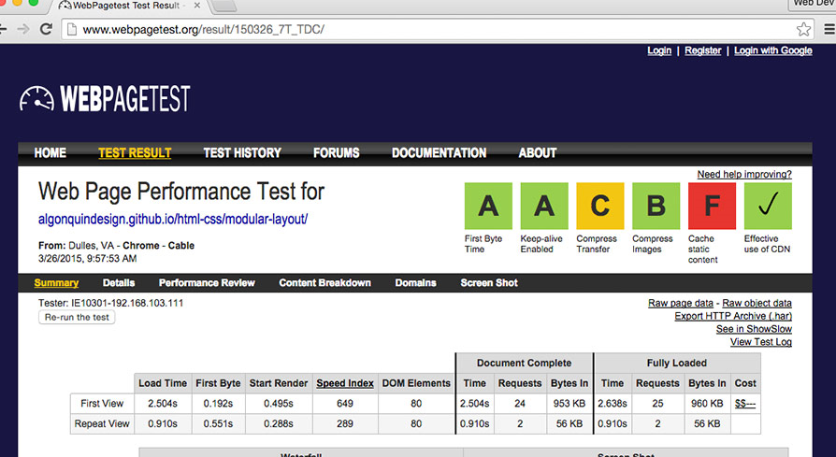
Introduction
Once the website is developed we must assess whether it performs according to certain criteria.
Our first consideration should be to revisit the scope of the website and investigate whether this is fulfilled.
The main concern at this early stage of the testing phase should be the website’s functionality.
More specifically the list of functions that the website is expected to perform.
Notes:
Website testing
Once the website is developed we must assess whether it performs according to certain criteria.
Our first consideration should be to revisit the scope of the website and investigate whether this is fulfilled.
The main concern at this early stage of the testing phase should be the website’s functionality.
More specifically the list of functions that the website is expected to perform.

Slide 4
Testing Aspects
User environments Meaning that it should aim at identifying the possible infrastructure needs and user environments that will be present when the website will be live, for example: traffic and bandwidth.
Links The functionality testing is primarily focused on the functions supported in each web page. However, some of these functions involve links. We must check all links existing in the website.
Navigation The navigation of the website must be checked thoroughly.
Notes:
Testing Aspects
User environments The testing of the website functionality should be realistic; meaning that it should aim at identifying the possible infrastructure and user environments that will be present when the website will be live.
Links The functionality testing is primarily focused on the functions supported in each web page. However, some of these functions involve links. We must check all links existing in the website.
Navigation The navigation of the website must be checked thoroughly.

Slide 5

Functionality Testing (1)
User Environment, means we could identify the following steps that could be part of the website functionality testing:
Checking the testing criteria
Performing a page by page check
Determining who the intended audience
Developing a test strategy based on checklists
Having in place a reporting system
Notes:
Functionality Testing
The main concern at the early stage of the testing phase should be the website’s functionality. More specifically the list of functions that the website is expected to perform. We could identify the following steps that could be part of the website functionality testing:
Checking the testing criteria - focusing on those aspects that are relevant to the website and that should be used for the functionality testing.
Performing a page by page check to ensure that each one is assessed.
Determining who the intended audience is and the support they require using the website functions.
Developing a test strategy based on checklists.
Having in place a reporting system to summarise and document testing results.
Testing each application that has been developed for the website and their integration.

Slide 6
Functionality Testing (2)
Testing each application that has been developed for the website Checking the configuration of the website
Assessing the website against certain performance indicators
Performing a regression test prior to the release of the website
Involving clients and end users
Producing the final website with any adjustments following the testing phase.
Notes:
Functionality Testing
Checking the configuration of the website
Assessing the website against certain performance indicators
Performing a regression test prior to the release of the website
Involving clients and end users
Producing the final website with any adjustments following the testing phase.

Slide 7
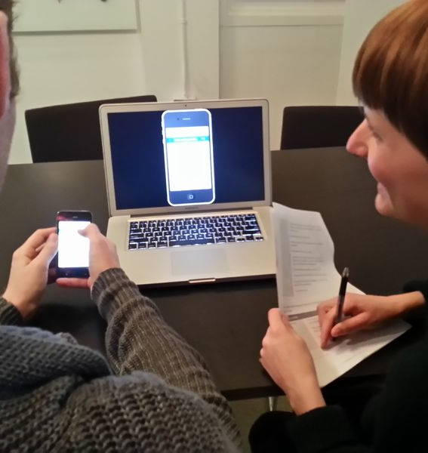
User Acceptance
To complete user acceptance testing, you can follow the following steps:
Producing a prototype to be used for testing.
Introducing certain test cases to be used as scenarios.
Comparing test results against expected results.
Brainstorming on the findings from the test.
Validating the website for accessibility and functionality.
Confirming the website meets user requirements.
Monitoring website performance.
Checking data accuracy and conformity with certain standards.
Notes:
User Acceptance
To complete user acceptance testing, you can follow the following steps:
Producing a prototype to be used for testing.
Introducing certain test cases to be used as scenarios.
Comparing test results against expected results.
Brainstorming on the findings from the test.
Validating the website for accessibility and functionality.
Confirming the website meets user requirements.
Monitoring website performance.
Checking data accuracy and conformity with certain standards.

Slide 8
Evaluating Web Sites for Accessibility
The W3C web accessibility initiative provides a resource suite for 'Evaluating Web Sites for Accessibility'. This resource includes a number of documents such as:
Preliminary Review of Web Sites for Accessibility
Conformance Evaluation of Web Sites for Accessibility
Evaluation Approaches for Specific Contexts
Involving Users in Web Accessibility Evaluation
Selecting Web Accessibility Evaluation Tools
Web Accessibility Evaluation Tools List Search
Using Combined Expertise to Evaluate Web Accessibility
Template for Accessibility Evaluation Reports
https://validator.w3.org/
Notes:
The W3C web accessibility initiative provides a resource suite for 'Evaluating Web Sites for Accessibility'. This resource includes a number of documents such as:
Preliminary Review of Web Sites for Accessibility (for identifying some potential accessibility problems on a Web site).
Conformance Evaluation of Web Sites for Accessibility (for determining if a website meets accessibility standards, such as the Web Content Accessibility Guidelines (WCAG)).
Evaluation Approaches for Specific Contexts (describing evaluation during the development process, ongoing monitoring, evaluation of legacy sites, and evaluation of dynamically generated web pages).
Evaluating Web Sites for Accessibility
Involving Users in Web Accessibility Evaluation (providing guidance on including people with disabilities ("users") in accessibility evaluation throughout Web development).
Selecting Web Accessibility Evaluation Tools (providing guidance on choosing which Web accessibility evaluation tools to use to help evaluate Web accessibility).
Web Accessibility Evaluation Tools List Search (providing a comprehensive list of Web accessibility evaluation tools that is searchable and sortable).
Using Combined Expertise to Evaluate Web Accessibility (describing the composition, training, and operation of teams of reviewers evaluating accessibility of Web sites).
Template for Accessibility Evaluation Reports (presenting a format for communicating results of a Web accessibility evaluation).

Slide 9
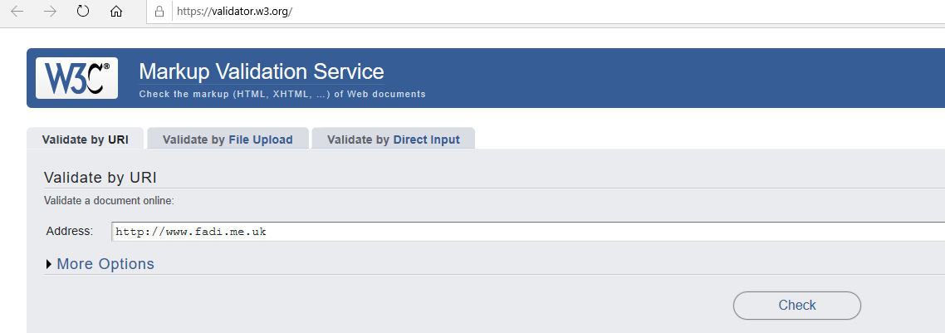
Evaluating Web Sites for Accessibility

Slide 10
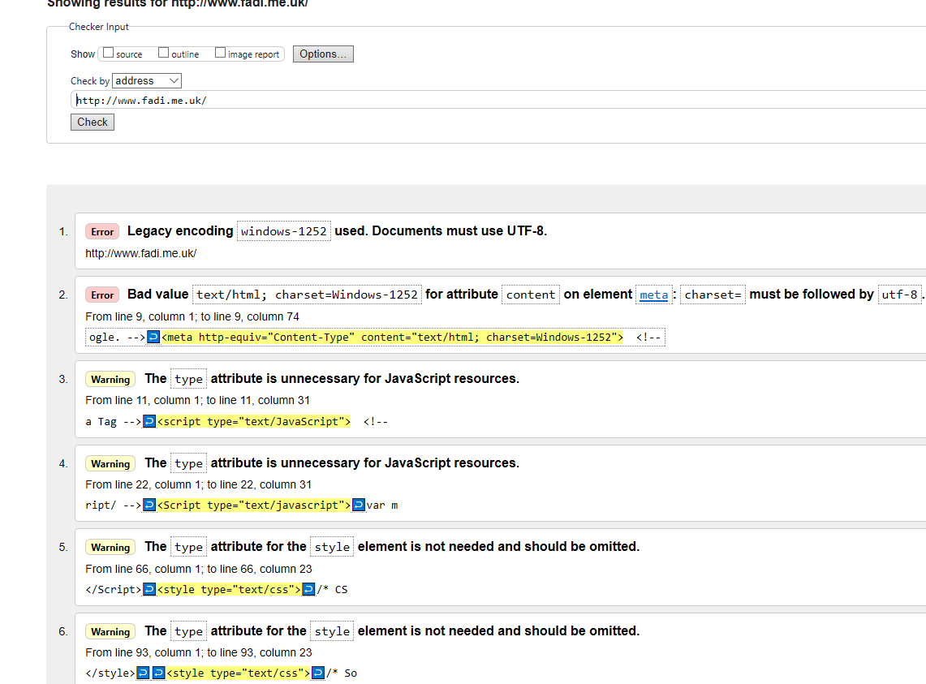
Evaluating Web Sites for Accessibility

Slide 11
Website Testing Check List (1)
The testing checklist that should be used by website developers should include all aspects such as:
Performing page-by-page testing
Tracking bugs
Logging fixes
Validating the mark-up of all pages
Validating CSS
Interoperability testing
Testing the optimisation of each page with updatesViewing pages on various displays
Viewing pages with different screen resolution and colour settings
Notes:
Website Testing Check List (1)
The testing checklist that should be used by website developers should include all aspects such as:
Performing page-by-page testing
Tracking bugs
Logging fixes
Validating the mark-up of all pages
Validating CSS
Interoperability testing
Testing the optimisation of each page with updates
Viewing pages on various displays
Viewing pages with different screen resolution and colour settings
Checking for colour contrast
Testing the functionality of embedded scripts and functions
Testing all links and navigation
Checking error pages
Testing downloads
Testing the search function
Checking whether sufficient security is in place
Testing forms and their controls

Slide 12
Website Testing Check List (2)
Checking for colour contrast
Testing the functionality of embedded scripts and functions
Testing all links and navigation
Checking error pages
Testing downloads
Testing the search function
Checking whether sufficient security is in place
Testing forms and their controls
Notes:
Website Testing Check List (2)
Viewing pages on various displays
Viewing pages with different screen resolution and colour settings
Checking for colour contrast
Testing the functionality of embedded scripts and functions
Testing all links and navigation
Checking error pages
Testing downloads
Testing the search function
Checking whether sufficient security is in place
Testing forms and their controls

Slide 13

User Feedback (1)
The aim of involving end users in an evaluation exercise of our website is to ensure that we will receive sufficient feedback to help us understand how our website performs against user requirements.
We could work towards understanding the following:
User satisfaction with the website.
User satisfaction with layout and design.
The ease of use for specific tasks.
The ease of use to locate information.
The understanding of navigation elements.
Notes:
User Feedback
The aim of involving end users in an evaluation exercise of our website is to ensure that we will receive sufficient feedback to help us understand how our website performs against user requirements. We could work towards understanding the following:
User satisfaction with the website.
User satisfaction with layout and design.
The ease of use for specific tasks.
The ease of use to locate information.
The understanding of navigation elements.
The usefulness of graphics.
The speed of downloads.
The stability of security measures.
The clarity of error messages.
The accuracy of information.
The ease of use for e-Commerce transactions.
The likelihood of returning users.
The likelihood of users recommending the website.
The significance of suggested improvements.

Slide 14
User Feedback (2)
The usefulness of graphics.
The speed of downloads.
The stability of security measures.
The clarity of error messages.
The accuracy of information.
The ease of use for e-Commerce transactions.
The likelihood of returning users.
The likelihood of users recommending the website.
The significance of suggested improvements.
Notes:
User Feedback 2
The speed of downloads.
The stability of security measures.
The clarity of error messages.
The accuracy of information.
The ease of use for e-Commerce transactions.
The likelihood of returning users.
The likelihood of users recommending the website.
The significance of suggested improvements.

Slide 15
Website Documentation
Documentation comes automatically when you are doing the analysis, design and implementation of the website. Therefore, it is important to be done as you go along. There are different types of documentation:
Analysis Documentation including databases and processes
Design Documentation such as wireframes, navigation diagram and storyboards
Implementation Documentation including all the tools and technologies used to develop the website
Maintenance Documentation
User Documentation including user guide, FAQ list, search facility
Notes:
Website Documentation
Documentation comes automatically when you are doing the analysis, design and implementation of the website. Therefore, it is important to be done as you go along. There are different types of documentation:
Analysis Documentation including databases and processes
Design Documentation such as wireframes, mood boards and storyboards
Implementation Documentation including all the tools and technologies used to develop the website
Maintenance Documentation
User Documentation including user guide, FAQ list, search facility

Slide 16
Thank You
Notes:
This is the end of the presentation. Thank you

